Slide 1
Laravel - Validation

Slide 2
Validation is the most important aspect while designing an application. It validates the incoming data. By default, base controller class uses a ValidatesRequests trait which provides a convenient method to validate incoming HTTP requests with a variety of powerful validation rules.

Slide 3
Available Validation Rules in Laravel
Laravel will always check for errors in the session data, and automatically bind them to the view if they are available. So, it is important to note that a $errors variable will always be available in all of your views on every request, allowing you to conveniently assume the $errors variable is always defined and can be safely used. The following table shows all available validation rules in Laravel.

Slide 4
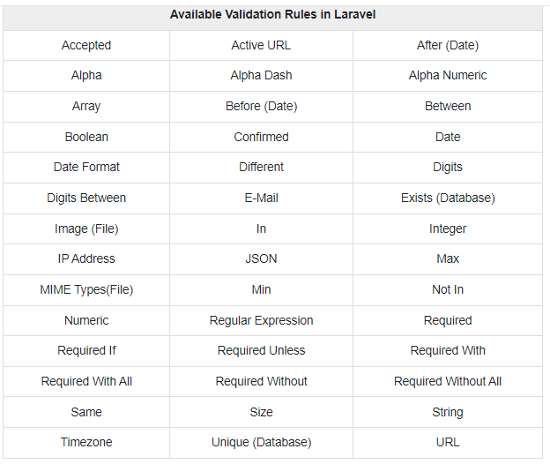

Slide 5
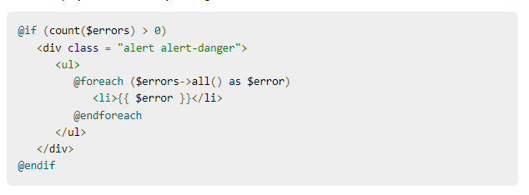
The $errors variable will be an instance of Illuminate\Support\MessageBag. Error message can be displayed in view file by adding the code as shown below.

Slide 6
